Slide 1
Bi-clustering
(in Gene Expression Data)
Dr. Haider Banka
Associate Professor
Depart. of Computer Science & Engineering, IIT(ISM), Dhanbad 826004, India.
email: haider@iitism.ac.in

Slide 2
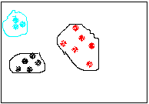
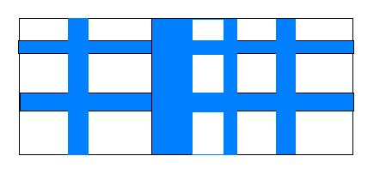
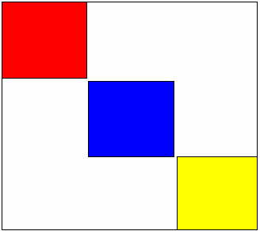
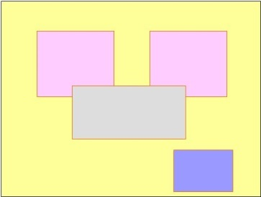
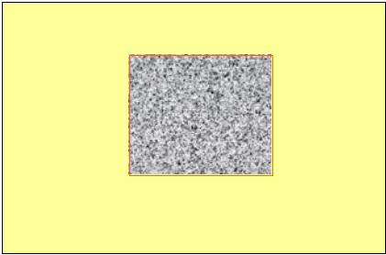
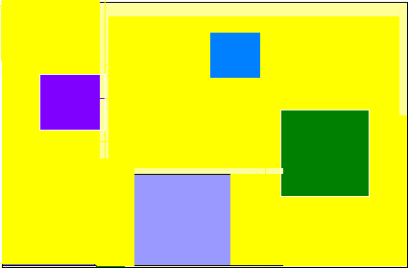
Pre : Traditional clustering
feature
Traditional clustering algorithms work in the full dimensional space.
consider all the features (attributes)
partitions over disjoint sets
f
e
a
t
u
r
e
Now : Bi-clustering
Bi-clustering, on the other hand, work on subset(s) of features and samples
partitions over overlapping sets
If some points are similar in several dimensions (a subspace), they will be clustered together in that subspace.
very useful, especially for clustering in a high dimensional space where often only some dimensions are meaningful for some subset of points.
feature
s
a
m
p
l
e
Overlapped & non-overlapped bi-clusters
Single and multiple bi-clusters
Some conditions
Some genes
Non overlapped
Overlapped
Single bi-cluster in a data matrix
Multiple bi-cluster in a data matrix

Slide 3
Challenge:
Bi-clustering identifies functionally correlated genes over a subset of features (experiments/conditions).
The approach is two-dimensional -- simultaneously
along gene/sample (row)
along feature/condition (column)
Bi-clustering of microarray data deals with finding coherent clusters along the gene-sample dimensions.
Bi-cluster: a subset of genes (g) and subset of experimental conditions (c) where the genes exhibit highly correlated/similar activities.
Microarray data is inherently susceptible to noise, due to varying conditions, essential that the methods be robust to noise.
As we do not understand the complex gene interaction circuitry in the cell, it is important that clustering methods allow overlapping clusters that share subsets of genes, samples or time-courses/spatial regions.
The methods should be flexible enough to mine several (interesting) types of clusters, and should not be too sensitive to input parameters.

Slide 4
Advantages of Bi-clustering over clustering in microarray data
Automatically selects coherent genes under certain experimental conditions, and drops the redundant conditions.
Groups items based on a similarity measure that depends on a context, which is best defined as a subset of attributes.
Discovers not only the grouping, but the context as well.
Allows rows and columns to be included in multiple bi-clusters, and thus allows one gene or one condition to be identified by more than one function categories.
added flexibility to reflect reality in the functionality of genes and overlapping factors under different experimental conditions.
Bi-clustering?
An NP-hard problem : Quality is often more important than the computation time required, GA provides an alternative efficient strategy in large search space. Fitness function was formulated in terms of mean squared residue score and size using single objective framework.
Multi-objective GA : Deals with a set of conflicting requirement/objectives, Converges to Pareto optimal front, Diversity among solutions are maintained. Two conflicting Requirements 1. Size, 2. Homogeneity. Hence more suitable for multi-objective modeling
A local search method : To ensure - Genes & Conditions having high MSR (Mean Squared Residue )are eliminated, Genes and Conditions having low MSR are added

Slide 5
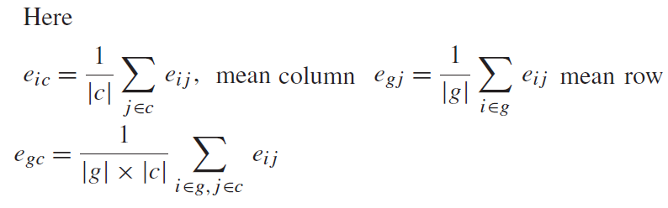
Mathematical Definition
A Bi-clustering is defined as a pair (g , c) with is a subset of genes &
is a subset of conditions. The optimization task is to find the largest bi-cluster that doesn’t exceed a certain homogeneity constraint stated below. The size (or, volume) f(g,c) = |g|*|c| of a bi-cluster is defined as the member of cells in the gene expression matrix E (with values eij) that are covered by it. The homogeneity G(g,c) is expressed as a mean squared residue score. We maximize f(g,c) = |g|*|c|, subject to a low G(g,c) <= for (g, c) belonging to X, where X = 2^[1,…,m] x 2^[1,….,n] being the set of all bi-clusters where
The user-supplied threshold , measures maximum allowable dissimilarity within the bi-cluster
Mean squared residue quantifies difference between actual value of an element from its expected value (predicted from the means)

Slide 6
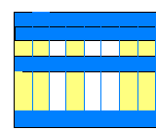
Preparing data for bi-clustering :Encoding of chromosome
1 2 3 4 5 6 7
1 2 3 4 5 6 7 8
1 | 1 | 0 | 1 | 0 | 0 | 1 | 1 | 1 | 0 | 1 | 0 | 0 | 1 | 1
7 rows Rows/genes
8 Conditions/columns
Conditions/columns
1 2 3 4 5 6 7 8
1
2
3
4
5
6
7
Rows/genes
7 x 8

Slide 7
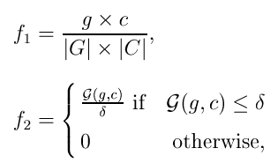
Multi-objective fitness functions
Maximize f₁, and f₂ as long as f₂ does not exceed the allowable dissimilarity

Slide 8
The main steps of the NSGAII
Generate a random population of size P.
Delete or add multiple nodes (genes and conditions) from each individual of the population.
Calculate the multi-objective fitness functions f₁ and f₂.
Rank the population using the dominance criteria.
Calculate crowding distance.
Perform selection using crowding tournament selection.
Perform crossover and mutation (as in conventional GA) to generate offspring population of size P.
Combine parent and offspring population.
Rank the mixed population using dominance criteria and crowding distance.
Replace the parent population by the best |P| members of the combined population.

Slide 9
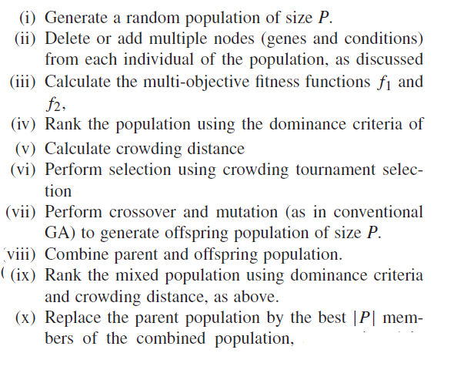
Bi-Clustering Evolutionary Algorithm

Slide 10
Conclusions
In this study we have introduced a multi-objective framework for bi-clustering gene expression data, incorporating local search for finer tuning.
A comparative study of result is performed on gene expression datasets.

